Slide 1


Optimizing Emergency Room Efficiency – A Data-Driven Approach
Turning ER data into actionable insights for better care.
by Yaswanth Kundurthi

Slide 2

Project Overview
Data Preparation
Dashboard Design
Cleaned and structured 400K+ ER records in Excel for analysis.
Created 4-page interactive Power BI dashboard with operational insights.
Decision Support
Built KPIs and heatmaps enabling data-driven ER workflow improvements.

Slide 3
Tools & Technologies
Excel
Power BI
DAX
Used for comprehensive data cleaning and preparation steps.
Developed visuals with DAX, slicers, and drillthrough functionalities.
Implemented custom KPIs and calculated columns for advanced metrics.

Slide 4
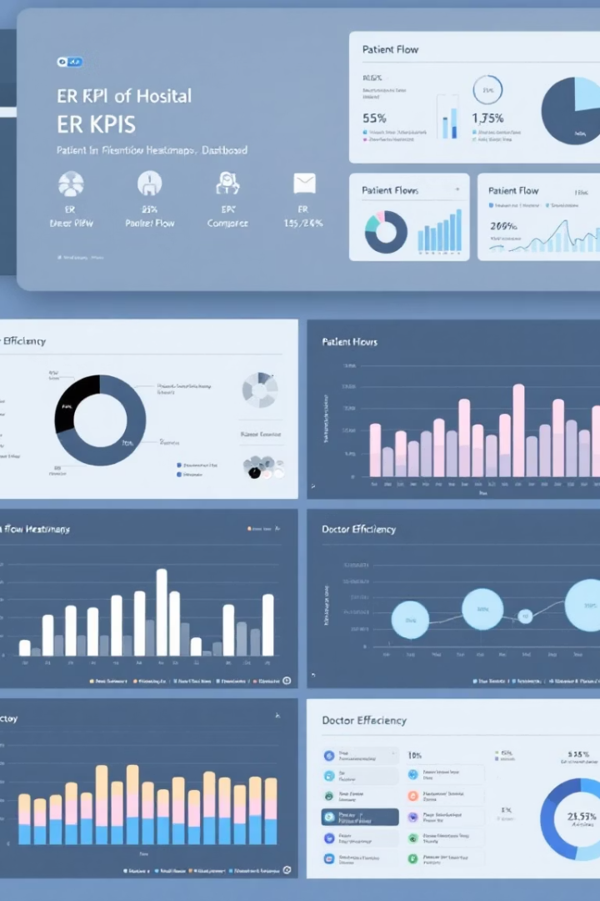
Dashboard Pages
1
Executive Summary
KPIs and patient visit trends at a glance.
2
Patient Flow
Heatmaps and triage-level patient movement analysis.
3
Doctor Efficiency
Box plots and insights on doctor performance and satisfaction.
4
Recommendations
Actionable strategies for hospital leadership.

Slide 5
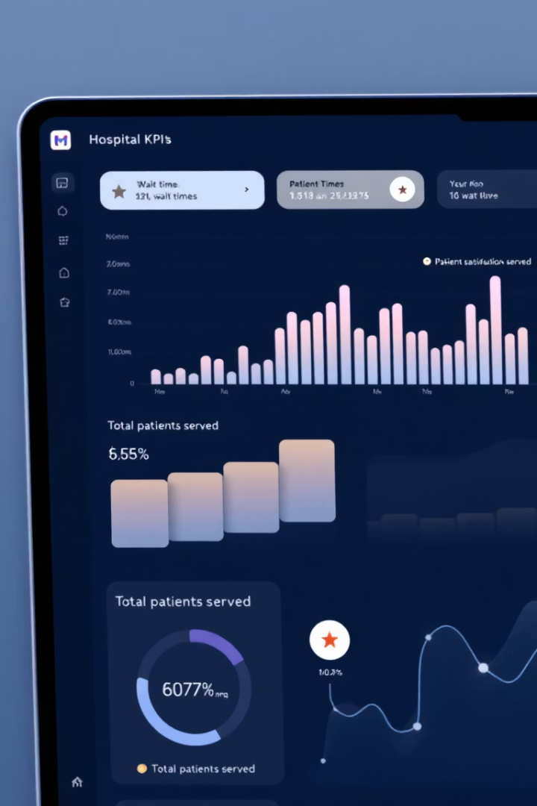
Executive Summary
Performance Snapshot
Enhanced Analytics
Moving averages calculated using DAX improve trend clarity.
Average wait time, satisfaction, and patient volume KPIs highlighted.
Interactivity
Bookmarks and drillthroughs create a dynamic user experience.

Slide 6
Patient Flow & Wait Times
Wait Time Comparison
Flow Visuals
Interactive Filters
Analyzed average wait times across departments and peak hours.
Tracked patient transitions using interactive flow diagrams.
Custom date slicers and tooltips enable detailed data exploration.

Slide 7
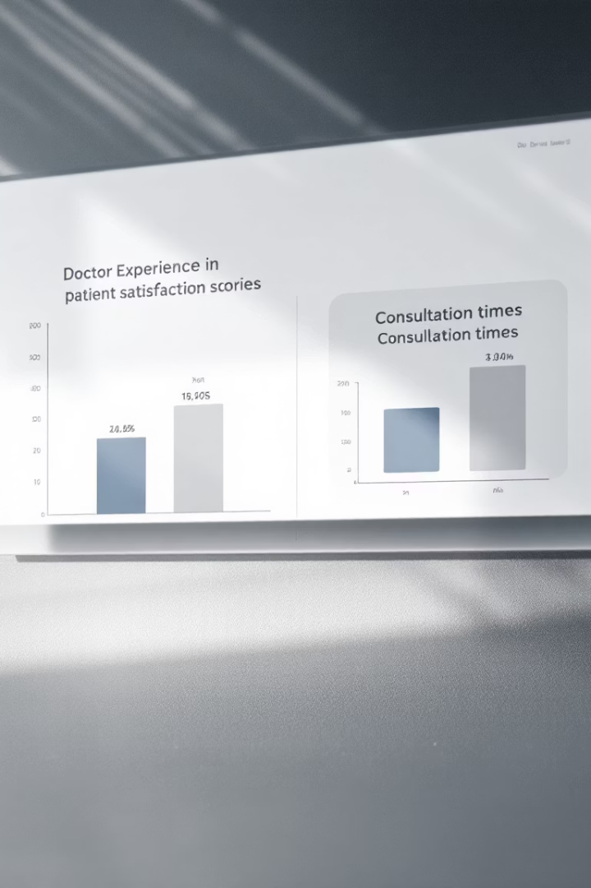



Doctor Efficiency & Patient Experience
Performance Metrics
Custom Visuals
Key Insight
Bar charts and box plots compared doctor experience levels.
Doctor experience did not directly correlate to efficiency.
Evaluated patient count and average consultation time by doctor.

Slide 8





Analyst Summary & Recommendations
Optimize Scheduling
Adjust staffing to peak demand hours for smoother operations.
Reduce New Patient Waits
Focus on shortening waits to improve satisfaction for newcomers.
Enhance Training
Improve onboarding of less experienced doctors to reduce variability.
Create Alerts
Use conditional formatting to flag long-waiting patients.

Slide 9

Thank You!
Open to Roles
Core Skills
Seeking entry-level Data Analyst positions.
Proficient in Power BI, Excel, SQL, and data storytelling.
Connect
Let's connect on LinkedIn! 🚀

